Slide 1
IMDB ETL PROCESS, DATA MODEL AND DATA WAREHOUSE

Slide 2
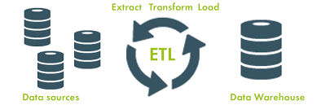
APPROCHES / STEPS TO PROCESS /METHODOLOGY:
Step 1 : Download and Importing the files into the Spark Environment
Step 2 : Create Spark Session and Configure with Pyspark
Step 3 : Installing all the important libraries to process the data
Step 4 : Read the JSON file in the Spark environment
Step 5 : Check the Metadata properties to validating the data
Step 6 : Plan for cleaning and slicing and dicing the data
Step 7 : Explode the array columns into multiple rows in data
Step 8 : Creating indivusals data frames to store the explode data
Step 9 : Merging multiple data frames to make consolidated data
Step10: Used some Data Redundancy Techniques to handling the duplicated records
Step11: Remove the Duplicates from the data
Step12: Made Final Dataset to create data warehouse to easy to analyzing the data
Step13: Make some reports and summaries to know hidden insights from the data

Slide 3
DIFICULTIES/ CHALLENGES FACED IN PROCCESING DATA :
Due to some system configuration I could not able to read the JSON file in the Spark
Used Pandas libraries to overcome Out Of Memory issue problem
Creating explode data frames for multiple array columns in data
Merging the multiple data frames with one to many relationships
Reducing the data redundancy to make consolidated data
Converting data frame into pyspark environment
Replacing special characters for multiple columns
Replacing missing data for multiple columns

Slide 4
DATA MODELING AND WAREHOUSE PART

Slide 5
STEPS ARE FOLLOWED TO BUILD A DATA WAREHOUSE:
Created a schema for Staging, dimension and fact
Created a staging, dimension and fact table with optimal data types, including relationships.
Uploaded the IMDB data file from Data lake to Azure SQL DB table(Stage table), i.e. truncate stage before every run
Loaded the Dimension table by using SQL procedure. (i.e. SQL Procedure can contain SCD methods also).
Loaded the Fact table(Surrogate keys and Rating) by joining required Dimensions and Stage table
Provided the scripts and some flow charts for references

Slide 6
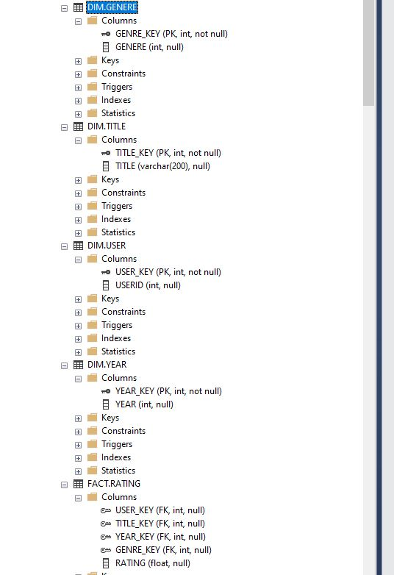
On the left, please find the meta data of Dimension and Fact table.

Slide 7
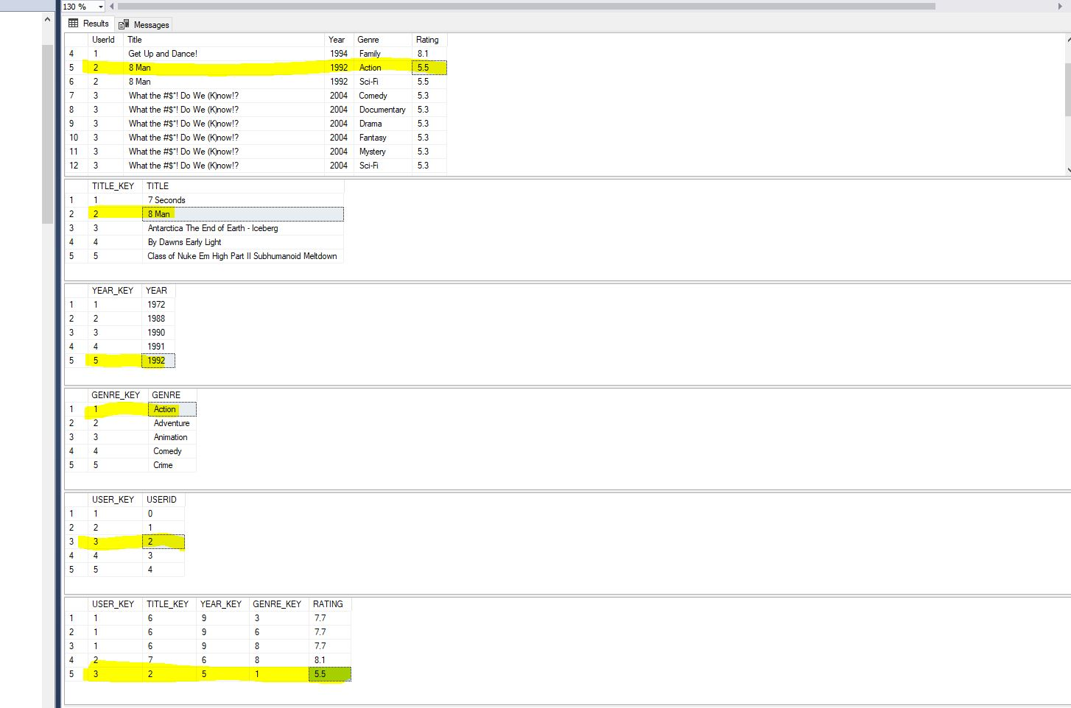
From the above screenshot, if we look at the fact table, if we see the last row highlighted in yellow color, we can get that the user key is 3, then we can get that the user id is 2, and then we can understand. It can be seen that in the dimension table the user id also has the same rating value, in fact we can confirm this in the Dimension table as well. And in the dimension table we can also see that the title is 8 men, year 1992, and the genre is action, we can also see them in the genre and year table.

Slide 8
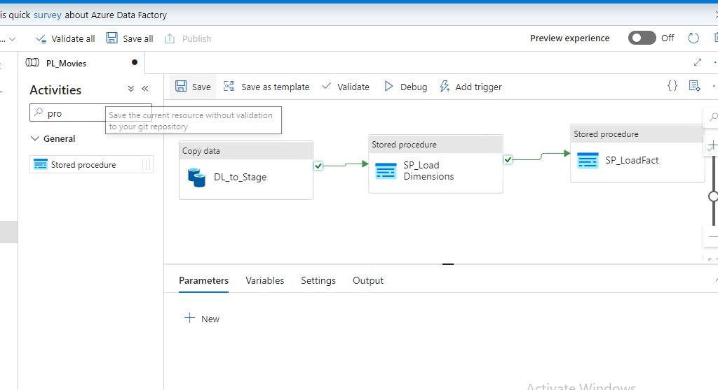
I have created a pipeline PL_Movies, And created a linked service LS_ADLS and created a datasets DS_Input_CSV, DS_Output_table.
Used Copy activity to load thefile from blob to SQL Staging table.
Used Stored Procedure activities to load Dimension and Fact tables.
We can create trigger and make it scheduled or event based to automate this load

Slide 9
THANK YOU
SANTHOSH BATHINI

